Slide 1
HuTUG
“Storage”, TSM szekció
2014. szeptember

Slide 2
Menü (Akvamarin terem)
9:30 - 10:00 Hasznos TSM-es linkek “10” percben
10:00 - 10:30 TSM kerekasztal, kötetlen beszélgetés
10:30 - 10:50 Kávészünet
10:50 - 11:35 Hatékony TSM üzemeltetés (Kósa Barna)
11:35 - 12:20 TSM v7.1.1 (Paul Weston)
12:20 - 13:20 Ebéd

Slide 3
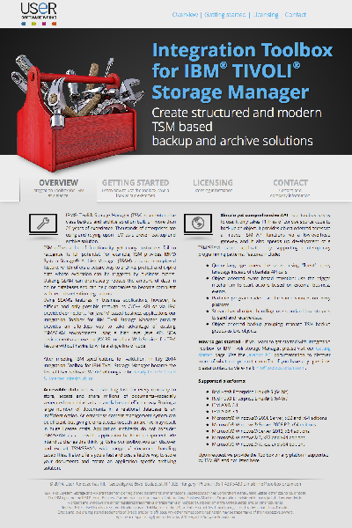
Integration Toolbox for IBM Tivoli Storage Manager
IBM Integrated Service Management Library http://www-304.ibm.com/software/brandcatalog/ismlibrary/details?catalog.label=1TW10SM59
http://www.toolboxfortsm.com/

Slide 4
Hasznos TSM-es linkek
10 percben
Letöltések
IBM-es hírlevlél
IBM developerWorks
TSM FAQ (Boston University)
Fórum (adsm.org)
Blog-ok…

Slide 5
Letöltések
IBM HTTP: http://service.boulder.ibm.com/storage/tivoli-storage-management/
http://www-947.ibm.com/support/entry/portal/all_download_links/tivoli/tivoli_storage_manager?productContext=-2105539168
IBM Fixcentral: http://www.ibm.com/support/fixcentral/

Slide 6
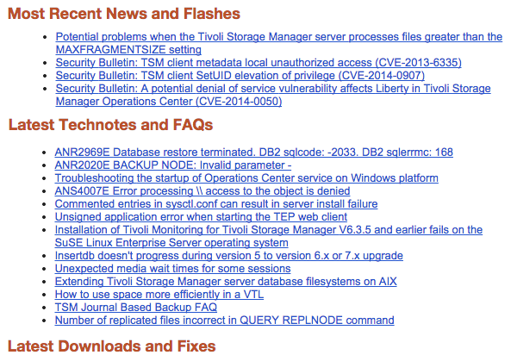
IBM-es TSM hírlevél
e-mail: itivinfo@us.ibm.com tárgy: subscribe Tivoli Storage Manager

Slide 7
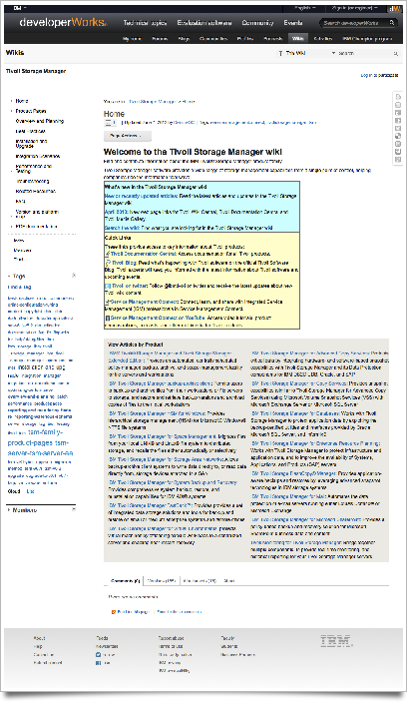
IBM developerWorks
Welcome to the Tivoli Storage Manager wiki
Tivoli Storage Manager for Virtual Environments
TSM Virtual Appliance
Forum

Slide 8
TSM FAQ (Boston University)
ADSM/TSM QuickFacts (5.425.003 bytes!!!) http://people.bu.edu/rbs/ADSM.QuickFacts
ADSM/TSM QuickFacts
in alphabetical order, supplemented thereafter by topic discussions
as compiled by Richard Sims,
Boston University (www.bu.edu), Information Services & Technology
On the web at http://people.bu.edu/rbs/ADSM.QuickFacts
Last update: 2013/10/04
This reference was originally created for my own use as a systems programmer's
"survival tool", to accumulate essential information and references that I knew
I would have to refer to again, and quickly re-find it. In participating in the
ADSM-L mailing list, it became apparent that others had a similar need, and so
it made sense to share the information. The information herein derives from many
sources, including submissions from other TSM customers. This, the information
is that which everyone involved with TSM has contributed to a common knowledge
base, and this reference serves as an accumulation of that knowledge, largely
reflective of the reality of working with the TSM product as an administrator.
I serve as a compiler and contributor. This informal, "real-world" reference is
intended to augment the formal, authoritative documentation provided by Tivoli
and allied vendors, as frequently referenced herein. See the REFERENCES area at
the bottom of this document for pointers to salient publications.

Slide 9
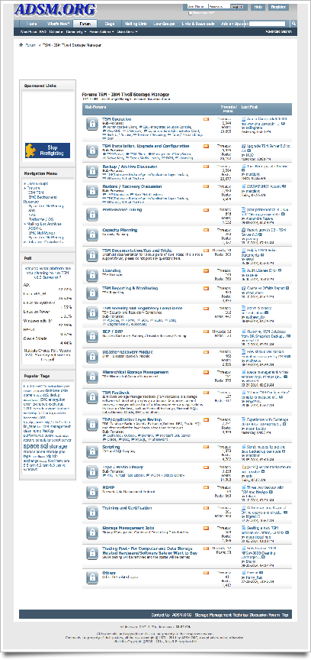
Forum - adsm.org
ADSM.org - Storage Management Technical Forum

Slide 10
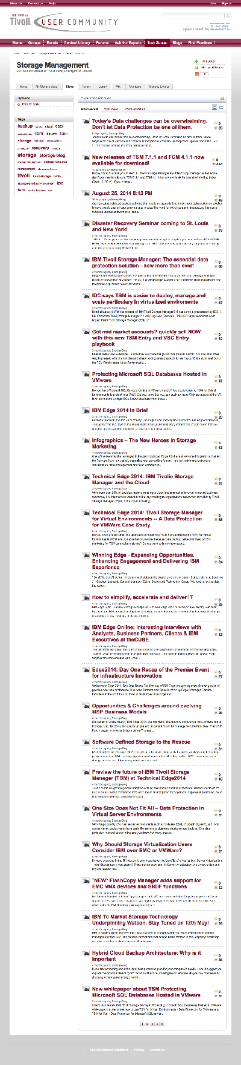
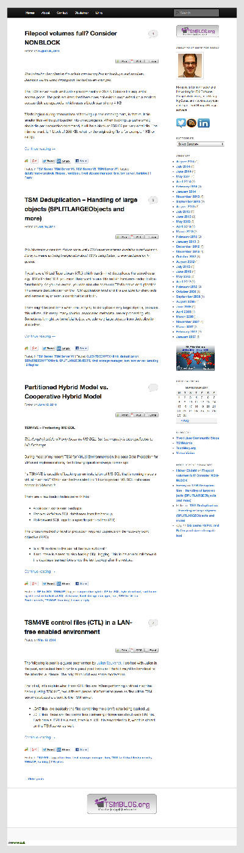
Blog-ok I.
Tivoli-UG, TUG: http://tivoli-ug.org/tech-zones/storage-management/b/weblog/ 2014. szeptember
Tommy Hueber: http://www.tsmblog.org/ 2014. augusztus
Chad Small: http://www.tsmadmin.com/ 2014. augusztus
http://www.tsmguru.com/ 2013. február
http://tsm62.blogspot.hu/ 2013. május

Slide 11
Blog-ok II.
https://rogerluethy.wordpress.com/tag/tsm/ 2014. szeptember
Anil K Y Ommi: http://www.tsmtutorials.com/ TSM Video Tutorials 2014. augusztus
Magyar! Soltész Zoltán http://vmware-tsm.blogspot.hu/ 2013. augusztus
Jackie Chen's IT Workshop http://jackiechen.org/tag/tsm/ 2014. április

Slide 12
Valami kérdés?

Slide 13
Menü (Akvamarin terem)
9:30 - 10:00 Hasznos TSM-es linkek “10” percben
10:00 - 10:30 TSM kerekasztal, kötetlen beszélgetés
10:30 - 10:50 Kávészünet
10:50 - 11:35 Hatékony TSM üzemeltetés (Kósa Barna)
11:35 - 12:20 TSM v7.1.1 (Paul Weston)
12:20 - 13:20 Ebéd

Slide 14
TSM kerekasztal, kötetlen beszélgetés !!!
TDP Oracle, MS Exchange, MS SQL, MS SharePoint(DocAVE), Lotus Domino, VMware, SAP
VSS/Snapshot
Space Management, HSM (Windows, UNIX)
Tivoli Storage FlashCopy Manager
Undocumented commands
Trace client/server
DRM, BRM, …

Slide 15

TSM kerekasztal, kötetlen beszélgetés
sebességverseny
------------------- -------- ------- ------------------- ------ ------- ---- -------- ---- ---- -- ---
Start End #Proc Node #E/A/F #Bytes Time Speed Idle MedW P Suc
------------------- -------- ------- ------------------- ------ ------- ---- -------- ---- ---- -- ---
xxxx-xx-xx xx:xx:xx xx:xx:xx xxxxxxx xxxxxxxxxxxxxxxxxxx x/x/x xxxxxx xxxx xxxxxxxx xxxx xxxx xx xxx
xxxx-xx-xx xx:xx:xx xx:xx:xx xxxxxxx xxxxxxxxxxxxxxxxxxx x/x/x xxxxxx xxxx xxxxxxxx xxxx xxxx xx xxx 2014-09-07 05:15:47 06:02:11 3696082 XXXX_ORA (XXXXORAX) 0/1/0 712 GB 46 M 262 MB/s 12 M 0 s 1 YES
.
.
.
xxxx-xx-xx xx:xx:xx xx:xx:xx xxxxxxx xxxxxxxxxxxxxxxxxxx x/x/x xxxxxx xxxx xxxxxxxx xxxx xxxx xx xxx
xxxx-xx-xx xx:xx:xx xx:xx:xx xxxxxxx xxxxxxxxxxxxxxxxxxx x/x/x xxxxxx xxxx xxxxxxxx xxxx xxxx xx xxx 2014-09-08 16:09:43 17:09:21 3726131 XXXX_ORA (XXXXORAX) 0/1/0 711 GB 60 M 203 MB/s 15 M 0 s 1 YES
.
.
.
xxxx-xx-xx xx:xx:xx xx:xx:xx xxxxxxx xxxxxxxxxxxxxxxxxxx x/x/x xxxxxx xxxx xxxxxxxx xxxx xxxx xx xxx
2014-09-11 03:03:31 03:59:50 3775752 XXXX_ORA (XXXXORAX) 0/1/0 719 GB 56 M 218 MB/s 15 M 0 s 1 YES
xxxx-xx-xx xx:xx:xx xx:xx:xx xxxxxxx xxxxxxxxxxxxxxxxxxx x/x/x xxxxxx xxxx xxxxxxxx xxxx xxxx xx xxx
.
.
.

Slide 16
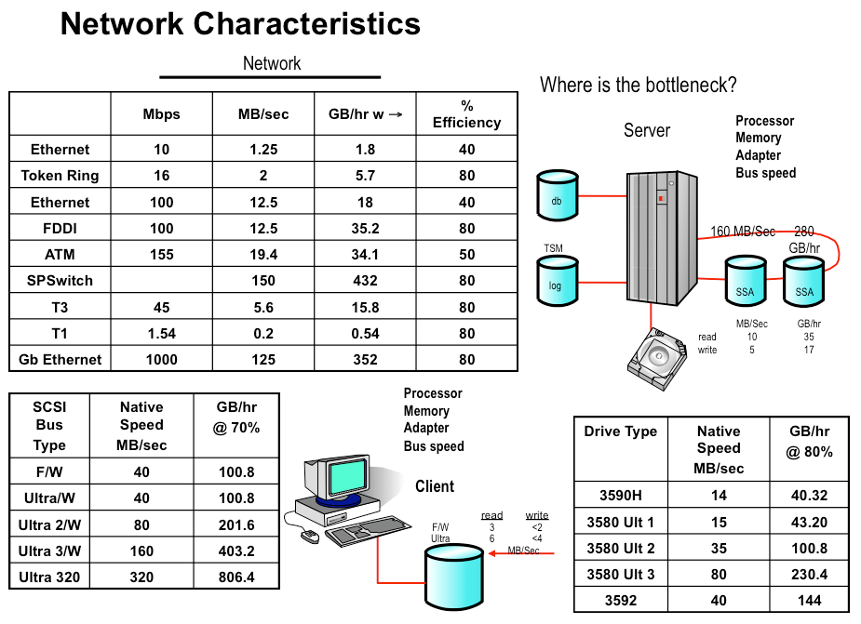
Speed II.

Slide 17
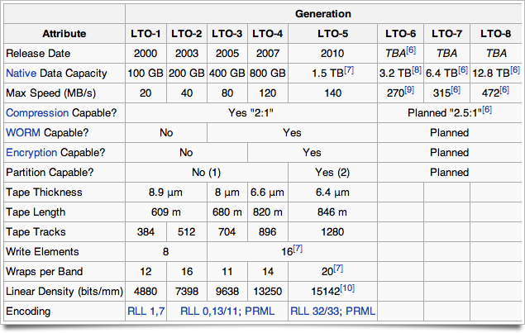
Speed III.

Slide 18
Sebesség
http://en.wikipedia.org/wiki/List_of_device_bit_rates
TS1140 (3592) Native sustained data rate (uncompressed) 250 MBps Burst data rate 800 MBps Adaptive instantaneous data rates 13 speeds, from 76 MBps to 251 MBps, for 3592 JC/JK/JY cartridges initialized in Gen 4 format
TS1060 Native data transfer rate 160 MBps; 576 GB/hour Dynamic speed matching at one of fourteen speeds: 160.0, 150.8, 141.5, 132.3, 123.1, 113.8, 104.6, 95.4, 86.2, 76.9, 67.7, 58.5, 49.2 or 40.0 MB/s

Slide 19
TSM kerekasztal, kötetlen beszélgetés
TDP Oracle, MS Exchange, MS SQL, MS SharePoint(DocAVE), Lotus Domino, VMware, SAP
VSS/Snapshot
Space Management, HSM (Windows, UNIX)
Tivoli Storage FlashCopy Manager
Undocumented commands
Trace client/server
DRM, BRM, …

Slide 20
Menü (Akvamarin terem)
9:30 - 10:00 Hasznos TSM-es linkek “10” percben
10:00 - 10:30 TSM kerekasztal, kötetlen beszélgetés
10:30 - 10:50 Kávészünet
10:50 - 11:35 Hatékony TSM üzemeltetés (Kósa Barna)
11:35 - 12:20 TSM v7.1.1 (Paul Weston)
12:20 - 13:20 Ebéd

